Slide 1
Medical Biology – Year 1
Lab 3: Wet mount slide
By Lecturer: Dr. Hanaa Ali Hussein
Department: Basic Sciences
College of Dentistry
University of Basrah
University of Basrah – College of Dentistry– Basic Sciences

Slide 2
Materials:- 1- clean slide 2- cover slip 3- sticker 4- methylene blue stain 5- Distilled water 6- Rack 7- Microscope
Preparing a wet mount slide
University of Basrah – College of Dentistry– Basic Sciences
2

Slide 3
Method:-
Preparing a wet mount slide
1- Take a piece of tissue from the epithelium of the cheek or pallet by using sterilized sticker.
2- Swab the scrubbed tissue on empty slide .
3- Put one drop of methyline blue or crystal violet on the slide where you have spread the cells and wait for 3 minutes.
University of Basrah – College of Dentistry– Basic Sciences
3

Slide 4
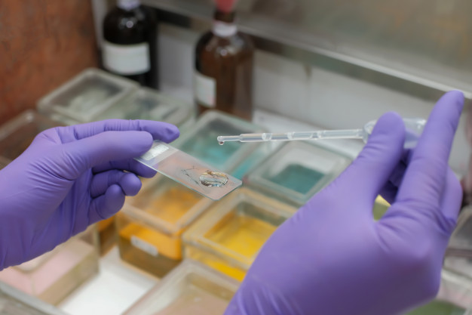
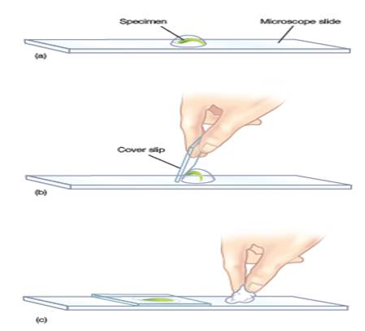
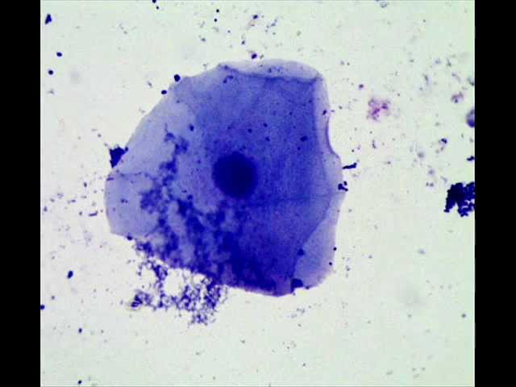
4- Wash up the stain using a distilled water.
Preparing a wet mount slide
Nucleus
Cell
Cytoplasm
Cell membrane
5- Slowly lower the upper edge of the cover slip onto the specimen, the excess water should be absorbed with paper.
6- Examine under light microscope
University of Basrah – College of Dentistry– Basic Sciences
4

Slide 5
Why we prepare a wet mount slide? The water helps support the sample and it fills the space between the cover slip and the slide allowing light to pass easy through the slide, the sample, and the cover slip.
University of Basrah – College of Dentistry– Basic Sciences
5

